Slide 1
AI Study Planner mindspark: Poloju Sriusha Sriramula Geetha Pabbathi Upender

Slide 2
agenda
Introduction
Phase-1: Brainstorming & Ideation
Phase-2: Requirement Analysis
Phase-3: Project Design
Phase-4: Project Planning (Agile Methodologies)
Phase-5: Project Development
Phase-6: Functional & Performance Testing
Final submission

Slide 3
Introduction An AI Study Planner is a smart tool designed to help you organize and manage your study schedule more efficiently. Using artificial intelligence, it creates personalized study plans based on your goals, preferences, and available time. The AI can suggest the best times for studying, recommend resources, and even remind you of upcoming tasks or deadlines. By using this planner, you can stay on track with your learning, improve time management, and reduce stress while preparing for exams or completing assignments. It’s like having a personal study assistant right at your fingertips!

Slide 4
Phase-1: Brainstorming & Ideation
Problem Statement:
*Students struggle with inefficient study habits due to overwhelming workloads and lack of personalized planning tools.
2. Proposed Solution:
*AI Study Planner provides personalized, adaptive study schedules that optimize learning and boost academic performance
3. Target Users:
*Students of all levels seeking a more organized and effective way to study.
4 . Expected Outcome:
*Students achieve better grades and academic performance
*Smarter studying, better results.

Slide 5
Phase-2: Requirement Analysis
Technical Requirements:
Programming Language: Python
Backend: Python (for AI).
Frontend: JavaScript (for web/phone).
AI Tools: scikit-learn,TensorFlow/PyTorch
Functional Requirements:
User Accounts: Create/login to profile.
Smart Planner: Creates daily schedule with suggestions.
3. Constraints & Challenges: Building takes time with limitations and initial hurdles around AI data.
Handling student private data with good security standards.

Slide 6
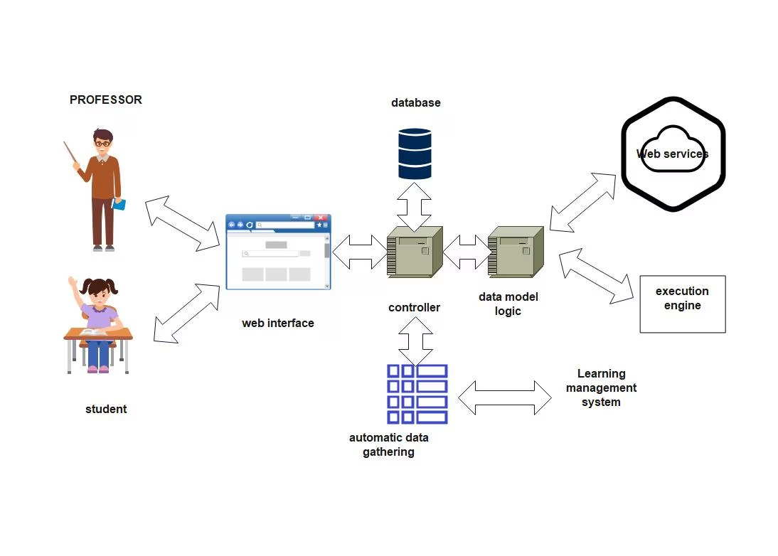
Phase-3: Project Design Objective: Develop the architecture and user flow of the application.

Slide 7
System Architecture:
User interacts with the frontend.
Frontend sends data requests to the backend Gemini API.
AI Engine processes data and sends results back to the backend
User Flow:
Step 1: start : sign up/log in
Step 2: input: Add courses &tasks .
Step 3: Schedule:Get a study plan
Step 4:Track mointor progress
3. UI/UX Considerations:
Clarity & Simplicity
Goal: Tailored experience for each user.
Aspects: Easy navigation ,quick task entry ,automated suggestions.

Slide 8
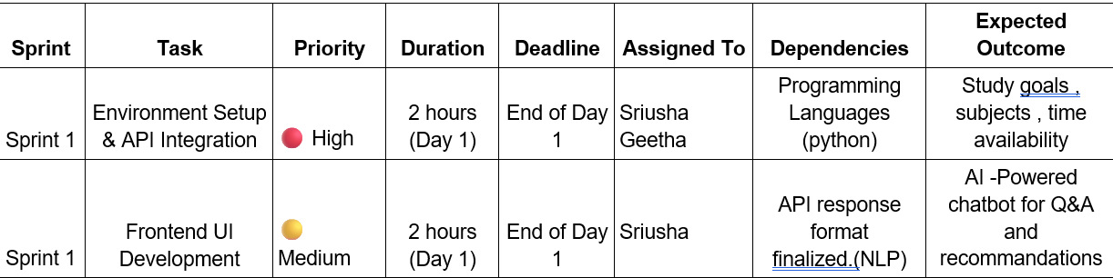
Phase-4: Project Planning (Agile Methodologies) Objective: Break down development tasks for efficient completion.

Slide 9
Sprint Planning with Priorities
Sprint 1 – Setup & Integration (Day 1)
(🔴 High Priority) Set up the environment & install dependencies.
(🔴 High Priority) Integrate Google Gemini API.
(🟡 Medium Priority) Build a basic UI with input fields.

Slide 10
Technology Stack Used:
Programming language: probably python (popular for AI)
Backend: Google Gemini Flash API
Programming Language: Python
Development Process:
AI Model:Train the AI to sugguest plans,resources.
Through Testing :Find and fix bugs
Challenges & Fixes:
Challenge: Not enough data,hard to personalize,low motitvation,complex subject,tech difficulty,privacy Fix: Start with basic data,user customization,check the result,use tools,keep the data safe.

Slide 11
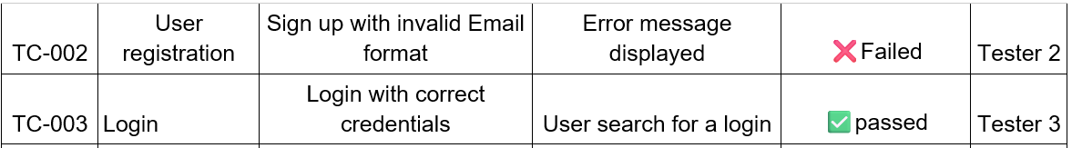
Phase-6: Functional & Performance Testing

Slide 12
Final Submission
Project Report Based on the templates
Demo Video (3-5 Minutes)
GitHub/Code Repository Link
Presentation

Slide 13


